Slide 1
DATE
10/07/2024
OPERATION ANALYTICS AND INVESTIGATING METRIC SPIKE
PRESENTED BY
Manu Moolimani

Slide 2

PROJECT DESCRIPTION
OPERTAION ANALYSIS
Operational Analytics involves analyzing a company's end-to-end operations to identify areas for improvement. This project focuses on deriving insights from various datasets to support decision-making in different departments within a company like Microsoft. By investigating metric spikes and understanding user engagement patterns, the project aims to improve the company's operations and address sudden changes in key metrics.

Slide 3

APPROACH
The data is analyzed on two case study
case study 1: Job Data Analysis
Working with a table named job_data, to extract valuable insights.
case study 2: Investigating Metric Spike
Working with three tables users, events, email_events here, I find out valuable insights that help improve the company’s operations
The approach involves:
Create Database and tables.
Data Exploration of the specified tables.
SQL Query Development.
Analyzing the results drawn from the SQL queries.

Slide 4
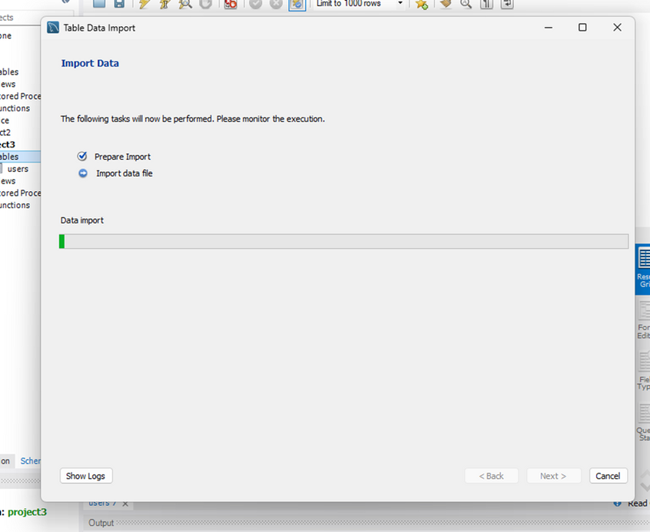

TECH STACK
MySQL Workbench v8.0.36 for its robust query building capabilities and visual database design.
SQL (Structured Query Language) is utilized for its efficient handling in relational database and performing complex queries or retrieval of data.

Slide 5
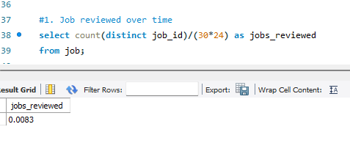
INSIGHTS
JOBS REVIEWED OVER TIME:
Identifying the number of jobs reviewed per hour for each day in the month of November,
count() is used with unique job_id and divided by 30 days of the month with hours of the day.

Slide 6
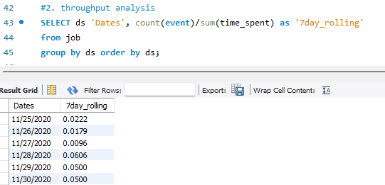
CASE STUDY 1
THROUGHPUT ANALYSIS:
The 7 day rolling average provides a better view of job processing efficiency,
The data is retrieved using count() divided by total amount of time spent.

Slide 7
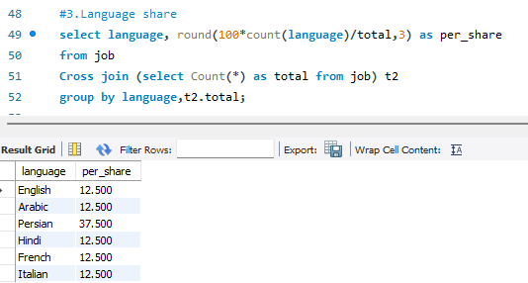
CASE STUDY 1
LANGUAGE SHARING ANALYSIS:
Language analysis can be used to reveal the dominant languages,
round() helps in rounding off the floating values, for finding the percentage share we use count().
Cross Join is used for the same table to get the cartesian product and then group by for filtering each language.

Slide 8
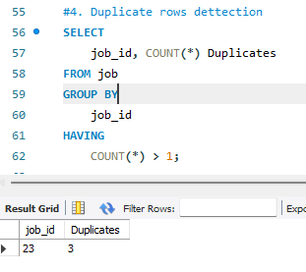
CASE STUDY 1
DUPLICATE ROW ANALYSIS:
Identified duplicate rows/entries in the job data, ensuring data accuracy and integrity.
To find the duplicate rows, i have filtered the row using group by and then i retrieve the count of ids repeated > 1.

Slide 9
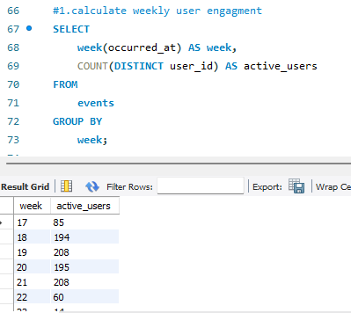
CASE STUDY 2
WEEKLY USER ENGAGEMENT:
Identifying the activeness of the users over weeks,
The activeness of the users is found by using week() to extract week from the date, and count of the job_id by filtering rows by the week number.

Slide 10
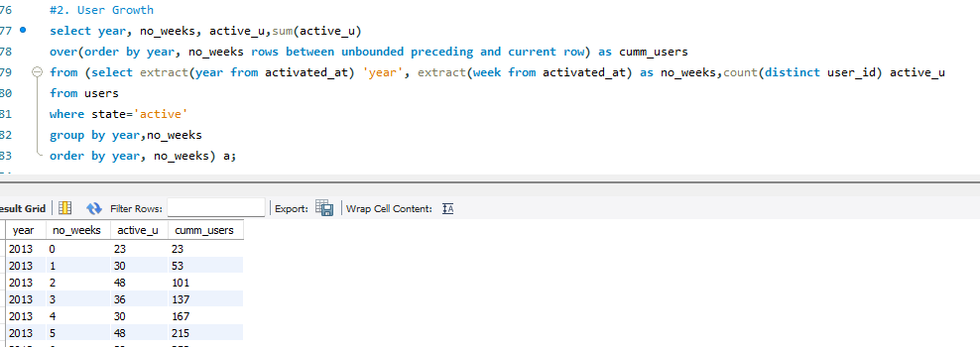
CASE STUDY 2
USER GROWTH ANALYSIS:
It shows the growth rate of the users over time,
To draw the growth rate from the users table, Window function is being used to aggregate operations and get all outputs.
Using group by clause we will group extracted week and year.

Slide 11
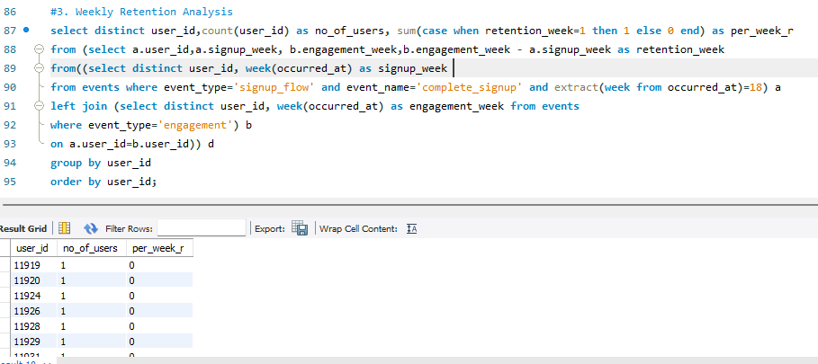
CASE STUDY 2
WEEKLY RETENTION ANALYSIS:
This data shows how long users stay active after signing up,
First, we extract the week from dates and use left join on events table.
group by clauses helps in getting the weekly retention for each users.

Slide 12
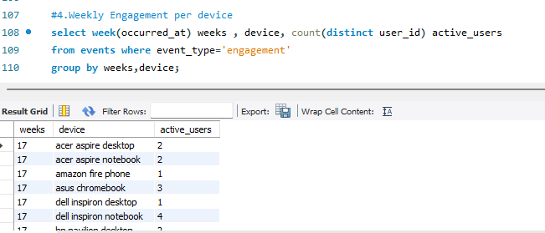
CASE STUDY 2
WEEKLY ENGAGEMENT PER DEVICE:
It reveals the device specific engagement of users on weekly basis,
With event_type, we are counting the unique user ids as active users to get the weekly engagement of users and their device.

Slide 13
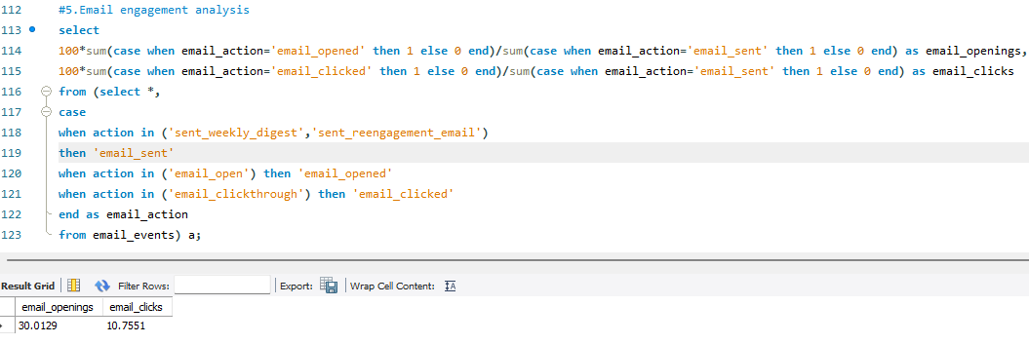
CASE STUDY 2
EMAIL ENGAGEMENT ANALYSIS:
Highlights the user interaction with the email,
It is achieved using the control flow function ‘case’, with the action as clicked and opened.
To find the email opening rate and clicked rate, we divide the sum of actions with emails sent and multiply it by 100.

Slide 14


RESULTS
This project enhanced skills in writing complex SQL queries, including subqueries, joins and control flow functions.
The detailed analysis of user activity improved my analytical thinking and producing the guiding analysis or marketing strategies to the company.
Improved ability to analyze and interpret data, drawing meaningful conclusions to support business decisions.

